Slide 1



MUSIC RECOMMENDATION SYSTEM
Presented By :- Mukul jain (2129078) Ashutosh dubey (2129128) Pradyumn Mukherjee (2129082) Alkesh Singh (2129021)

Slide 2

CONTENT
Introduction | 3
Proposed Timeline | 4
Problem Statement | 5
Framework | 6
Methodology | 7
Analysis | 12
Challenges | 13
Future Scope | 14
Conclusion | 15
References | 16

Slide 3
INTRODUCTION
Music in the world has undergone a transformative evolution. With the rise of streaming platforms, music lovers now have access to an unprecedented abundance of songs spanning genres, eras, and cultures.Music recommendation systems leverage advanced algorithms and data analysis techniques to provide personalized music suggestions tailored to each user's unique preferences and listening habits. These systems have become integral components of streaming platforms, online radio stations, and music discovery services, enhancing the user experience and driving engagement.

Slide 4

Proposed Timeline
JANUARY
FEBRUARY
MARCH
APRIL
Selecting the problem statement, setting objectives, gathering the dataset.
Exploring methods to be used in the project. Experimenting with different machine learning algorithms
Implementation and testing of the machine learning algorithms
Documentation of the project. Writing report and making presentation.
Back to Content

Slide 5
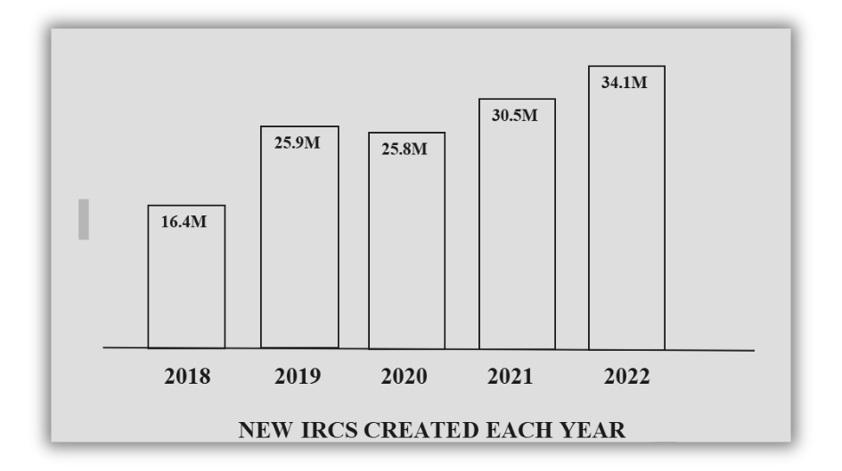
PROBLEM STATEMENT
SCOPE OF THE STUDY | 1.Data Collection. 2.Data Preprocessing. 3.Dataset Description. 4.Recommendation Algorithms. 5.Evaluation.
RELEVANCE OF THE STUDY | The ultimate goal of this project is to deliver an intelligent music recommendation system that enhances music discovery, increases user engagement, and provides a seamless listening experience for users across diverse musical preferences.
The objective of this project is to develop an intelligent music recommendation system that leverages advanced algorithms and data analysis techniques to deliver personalized music suggestions tailored to each user's unique preferences and listening habits.
Every day 1,20,000 new songs are uploaded. Thats 1.25 songs every second and 43 million in a year alone. Thats why it is a necessity to develop a music recommendation system that can listen, analyse, categorise, generalise and sort music into libraries
Back to Content

Slide 6

FRAMEWORK
OVERVIEW | PROPONENTS
This framework provides a structured approach to developing a music recommendation system, covering various aspects such as data collection, algorithm selection, user interface design, evaluation, deployment, and future enhancements. It can serve as a guideline for organizing and presenting the project. | Data Preprocessing: Data Cleaning Data Normalisation Data Encoding Model selection: 1.KNN(K-Nearest Neighbours) 2.Logistic regressionn 3. Random Foresstt 4. Decision Tree. Model Evaluation: The performance of the models is evaluated using the testing dataset. The evaluation metrics used are accuracy, Precision, Recall, F1 score and AUC Testing: ROC Precision-Recall Curve Confusion Matrix Heatmap

Slide 7
MODEL SELECTION
1.KNN(K-Nearest Neighbours) 2.Logistic regressionn 3. Random Foresstt 4. Decision Tree.
MODEL EVALUATION
The performance of the models is evaluated using the testing dataset. The evaluation metrics used are accuracy, precision, recall, F1 score and AUC.
METHODOLOGY
Back to Content

Slide 8
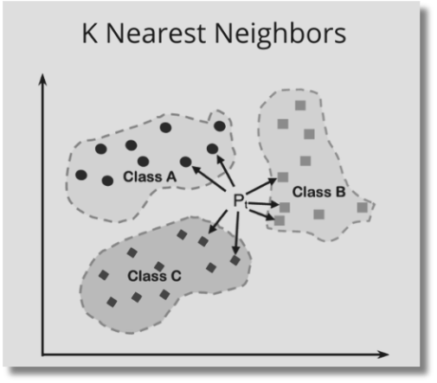
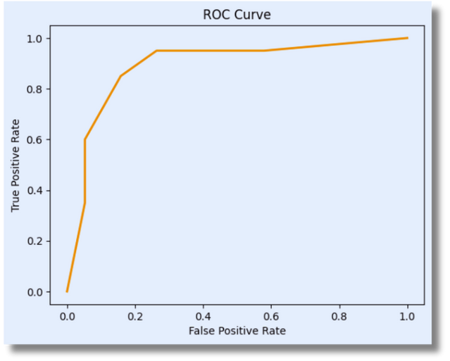
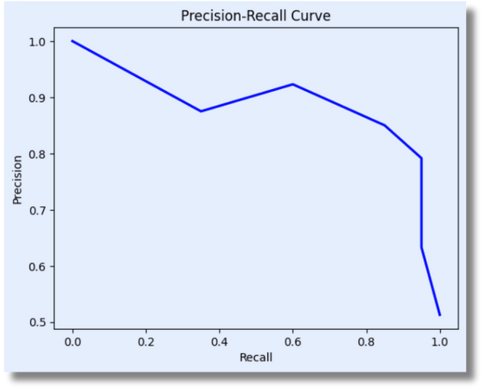
KNN MODEL
K-Nearest Neighbors (KNN) is a widely used machine learning algorithm for classification and regression tasks.A non-parametric, supervised learning classifier, the k-nearest neighbors (KNN) algorithm employs proximity to classify or forecast how to group a single data point.
The KNN model is trained with and random state of 42.
The best hyperparameters are test size of 0.2 .

Slide 9
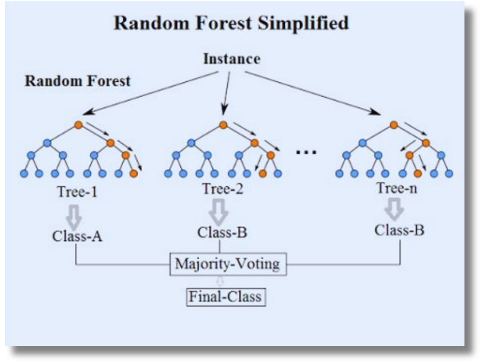
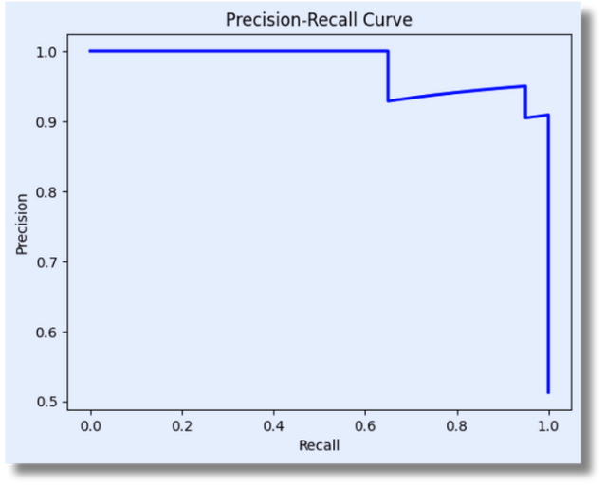
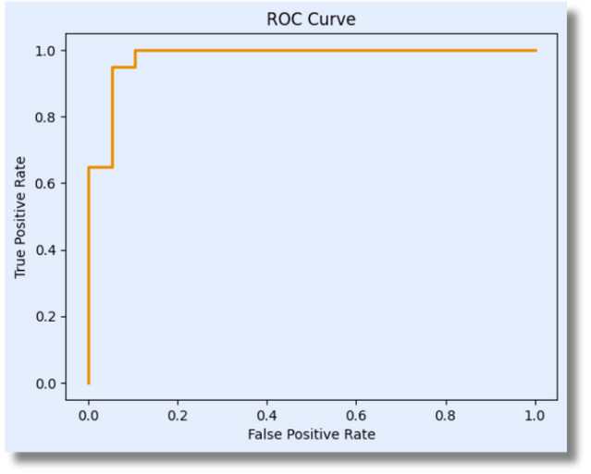
RANDOM FOREST
Random Forest is a machine learning algorithm which aggregates the output of several decision trees to produce a single outcome. Its versatility and ease of use, combined with its ability to handle both regression and classification issues, have driven its popularity.
The Random Forest model is trained with random state of 39.
The best hyperparameters are n_estimators=100.

Slide 10
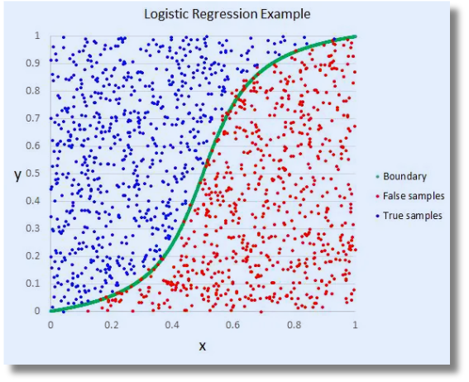
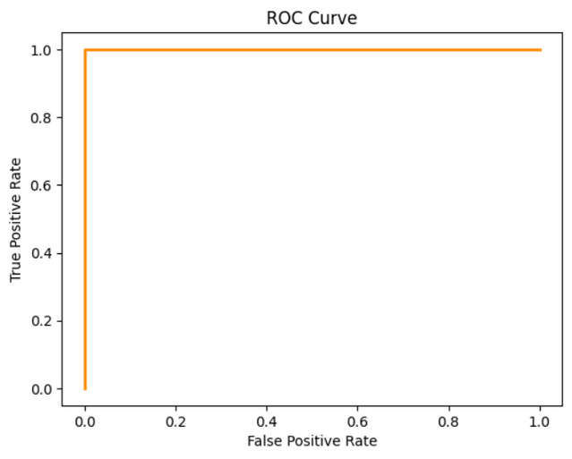
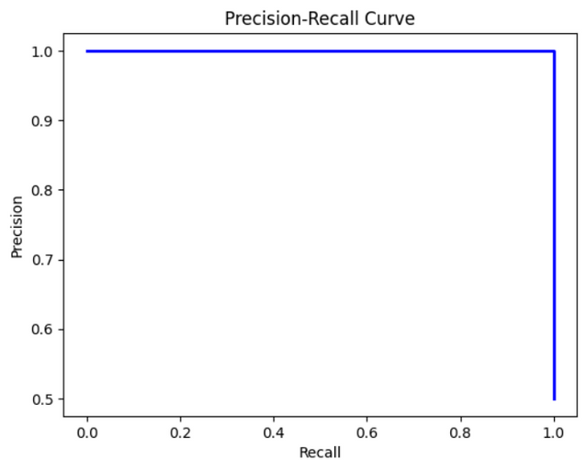
LOGISTIC REGRESSION
Logistic Regression is a machine learning algorithm for classification problems where the objective is to predict the likelihood that an instance belongs to a specific class or not, one supervised machine learning approach that is utilized is called logistic regression. A statistical method called logistic regression examines the connection between two data elements.
The logistic regression model is trained with a test size of 0.2 and random state of 42.
The best hyperparameters are test size of 0.2.

Slide 11
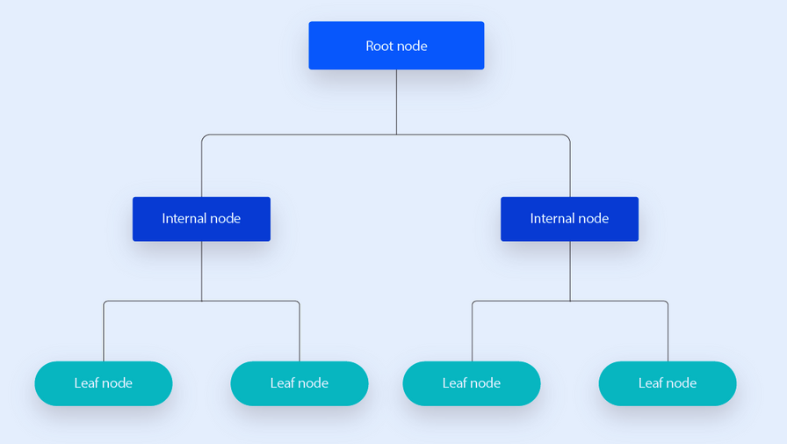
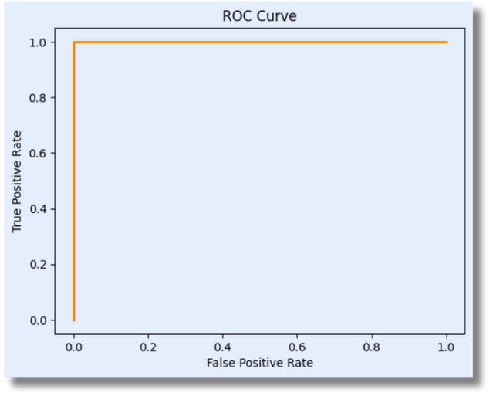
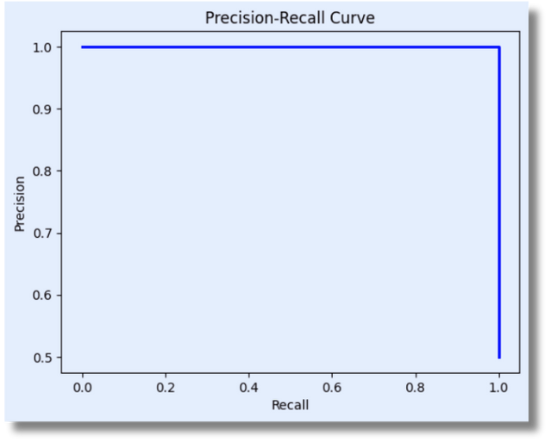
DECISION TREE
A decision tree is a machine learning algorithm in which a type of tree structure resembles a flowchart, with core nodes representing features, branches representing rules, and leaf nodes representing the algorithm's outcome.
The Decision Tree model is trained with test size of 0.2 and random state of 42.
The best hyperparameters are test size of 0.21.

Slide 12
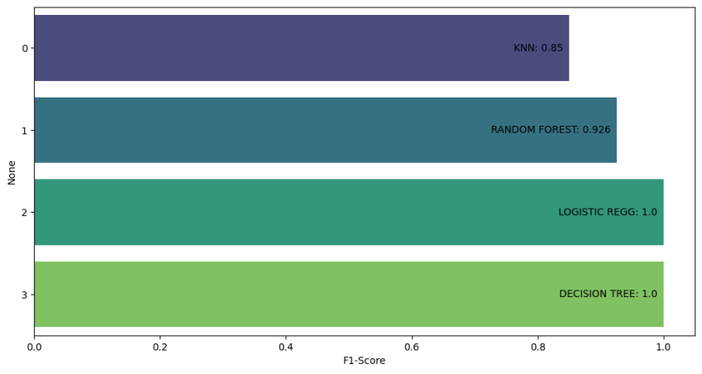
ANALYSIS
F1 score is used for evaluating the performance of a classification model. It considers both precision and recall to provide a single measure of a model's accuracy, particularly useful when dealing with imbalanced classes.
Back to Agenda
Back to Content

Slide 13

CHALLENGES
Music recommendation systems face several challenges, including:
Cold Start Problem: This refers to the difficulty of recommending music to new users or items with little to no historical data. Without sufficient data, it's hard to make accurate recommendations.
Data Sparsity: Even for existing users, the amount of data available for their preferences can be limited. Users may rate or interact with only a small fraction of the available music, leading to sparse user-item interaction matrices.
Dynamic Preferences: Users' music preferences can change over time due to various factors such as mood, context, or discovery of new genres. Recommendation systems need to adapt to these changing preferences.
Long-Tail Distribution: Music libraries often exhibit a long-tail distribution, with a few popular items and a vast number of niche or less popular ones. Recommending items from the tail of this distribution accurately is challenging.
Contextual Information: Recommendations can be greatly enhanced by considering contextual information such as time of day, location, activity, or mood. Incorporating and interpreting this information accurately adds complexity to the recommendation process.
Back to Content

Slide 14

FUTURE SCOPE.
 | Machine learning (ML)-based music recommendation systems have a bright and wide future ahead of them. The following are some possible paths and developments: Personalization: By taking into account listener history, mood, context, individual preferences, and even physiological data, machine learning algorithms can further enhance the personalization of music recommendations. In order to modify recommendations in real time, future systems might incorporate more advanced user profiling methods and real-time feedback.
Back to Content

Slide 15

CONCLUSION
THE EFFECTIVENESS OF A MUSIC RECOMMENDATION SYSTEM HINGES ON ITS ABILITY TO DELIVER PERSONALIZED AND DIVERSE SUGGESTIONS WHILE ENHANCING THE OVERALL USER EXPERIENCE. BY ACCURATELY MATCHING USERS WITH MUSIC THEY ENJOY, THE SYSTEM PROVES ITS WORTH, WHICH CAN BE GAUGED THROUGH USER FEEDBACK AND ENGAGEMENT METRICS
 | Music Recommendation System's success lies in its ability to provide personalized, diverse recommendations that enhance the user experience while considering ethical implications and driving positive business outcomes
Back to Content

Slide 16
References
1 Aiolli, F. (2012). A preliminary study on a recommender system for the million songs dataset challenge. PREFERENCE LEARNING: PROBLEMS AND APPLICATIONS IN AI
2 Spotify. (2013, March) Spotify Music for everyone. [Online].
3 Peter Knees and Markus Schedl. Music retrieval and recommendation – a tutorial overview. In Proceedings of the 38th Annual International ACM SIGIR Conference on Research and Development in Information Retrieval (SIGIR), Santiago, Chile, August 2015.
4 Peter Knees and Markus Schedl. Music Similarity and Retrieval: An Introduction to Audio- and Web-based Strategies. 2016.
5 Chris Johnson. From idea to execution: Spotify’s discover weekly. November 2015.
[6] Toward the Next Generation of Recommender Systems: A Survey of the State-of-the-Art and Possible Extensions, Gediminas Adomavicius, Alexander Tuzhilin, IEEE Members
[7] Creating a Hybrid Music Recommendation System from Content and Social-Based Algorithms Jamie Cai, John Francis, Stephen Gheysens, Rutgers University, GSET „09
[8] http://en.wikipedia.org/wiki/Acoustic_fingerprint, Sun, 24-10-2010
[9] http://marsyas.info, Sun 24-10-2010

Slide 17
THANK YOU

